Slide 1


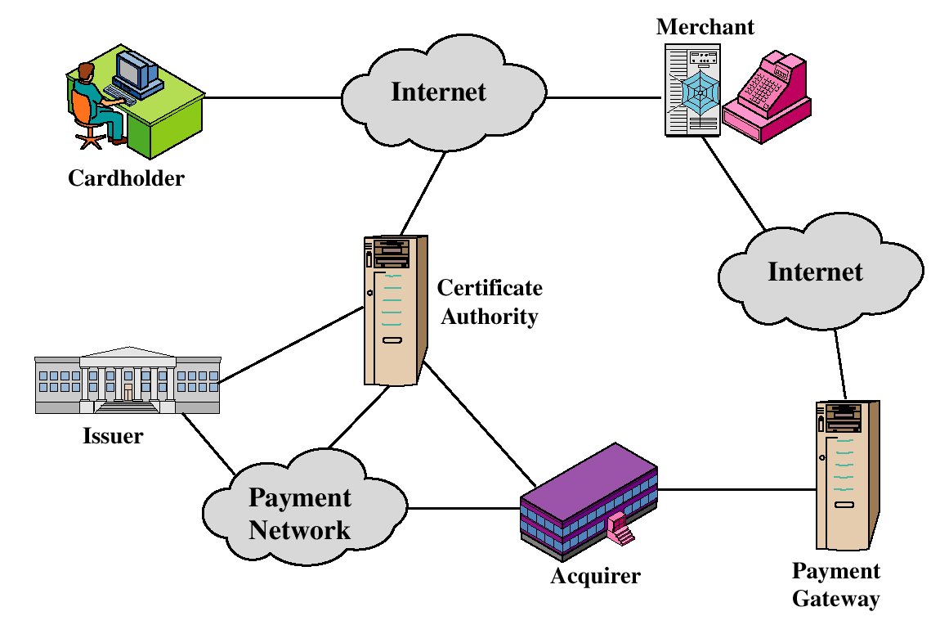
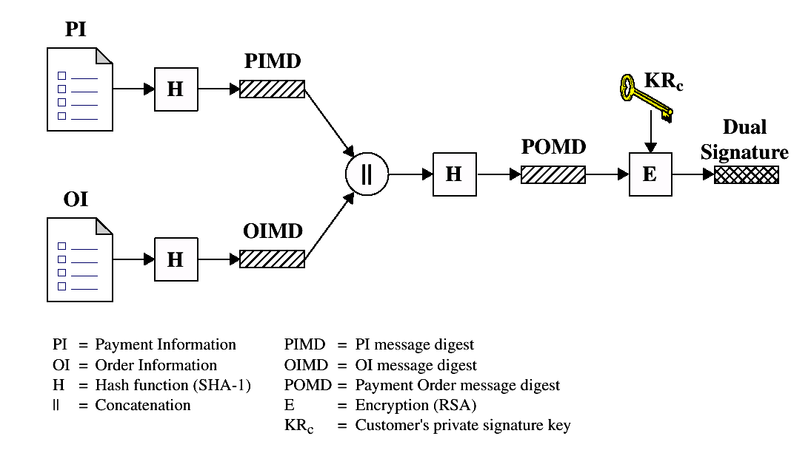
SET
Secure Electronic Transaction
Protection to Credit Card Transaction
Names: Hira Saleem, Iqra, Sidra, Fardeen Instructor: Asima Nisar
Secure Electronic
Transaction (SET)
An open encryption and security specification.
Protect credit card transaction on the Internet.
Companies involved:
MasterCard, Visa, IBM, Microsoft, Netscape, RSA,Terisa and Verisign
Not a payment system.
Set of security protocols and formats.
SET PARTICIPANTS
SEQUENCE OF EVENTS
The customer opens an account.
The customer receives a certificate.
Merchants have their own certificates.
The customer places an order.
The merchant is verified.
The order and payment are sent.
The merchant request payment authorization.
The merchant confirm the order.
The merchant provides the goods or service.
The merchant requests payments.
DUAL SIGNATURE
  The customer takes the hash(using SHA-1) of the PI and the hash of the OI.
  These two hashes are then concatenated and the hash of the result is taken.
  Finally, the customer encrypts the final hash with his or her private signature key, creating the dual signature.
  The operation can be summarized as
  DS=E(PRc{H(PI) || H(OI)})
SERVICES
Provides a secure communication channel in a transaction.
Provides trust by the use of X.509v3 digital certificates.
Ensures privacy.
KEY FEATURES OF SET
  Confidentiality of information
  Integrity of data
  Cardholder account authentication
  Merchant authentication
PAYMENT PROCESSING
Payment Authorization
  Authorization Request
  Authorization Response
  Payment Capture
  Capture Request
  Capture Response

